Slide 1

Android Application
Building Blocks

Slide 2

Homework stats
Top submitters
  Andrejs Soboļevs
  Данил Лучанский
  Artjoms Stukans
  Vitaly Derkach
Support
  alex.buzdin@gmail.com
  svires@gmail.com
  vladimir.kotov@gmail.com

Slide 3

Intents and Intent Filters

Slide 4

Anatomy of Android application
Broadcast Receivers
Intents
Activities
Services
Views
Content Providers

Slide 5

Intents
Message-passing mechanism on Android
Facility for late run-time binding between components
    activities, services, broadcast receivers
    same or different applications
Passive data structure describing
    operation to be performed
    something that has happened

Slide 6
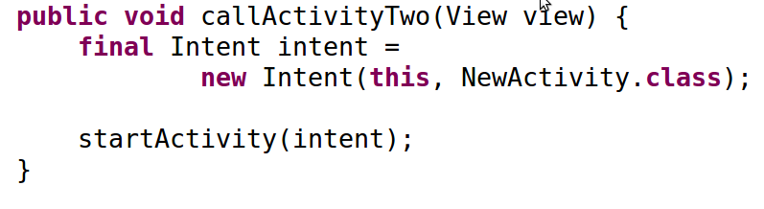
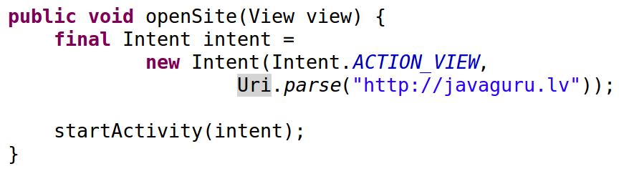
Intents In Action
(A) Activity starts another activity by sending an Intent
(B) Activity starts another activity by creating an intent that says “View site javaguru.lv”

Slide 7

Intents
Action propagation via Intents is Android design principle
  modular architecture
  event-driven applications
  decoupling of components
  seamless replacement of application elements

Slide 8

Intent Object
Component name
  Component name that should handle the intent
  setClassName("package", "package.Activity")
  setClassName(this, "package.Activity")
Action
  string naming the action to be performed
  determines how data and extras fields are structured
  ex., ACTION_VIEW, ACTION_CALL, ACTION_EDIT
Data
  URI and the MIME type of the data

Slide 9

Intent Object
Common Action/Data Pairs
  ACTION_VIEW http://www.javaguru.lv
    view site in browser
  ACTION_DIAL content://contacts/people/1
    dial person
  ACTION_VIEW tel:123
    show dialer with the number
  ACTION_DIAL tel:123
    dial the number
  ACTION_VIEW content://contacts/people/
    list of contacts

Slide 10
Intent Object
Category
  Additional information about the target component
  LAUNCHER - initial activity of a task
  HOME - activity displays the home screen
  PREFERENCE - activity is a preference panel
Extras
  Additional information delivered to the component
  handling the intent (key-value pairs)
Flags

Slide 11

Intent Resolution
Determine component to handle passed intent
Types of Intents
  Explicit intents - designate the target component by its class name
    new Intent(this, ActivityX.class)
  Implicit intents - do not name a target; component to handle the intent is found via intent filters
    new Intent(ACTION_VIEW,Uri.parse("http://lv"))

Slide 12

Intent Filters
Set up in application's manifest
Describe capabilities of target components
Inform which implicit intent a component can handle
Intent object are tested against intent filters
    Action, Category, Data
User may be asked to choose is intent can pass through the filters of multiple activities

Slide 13
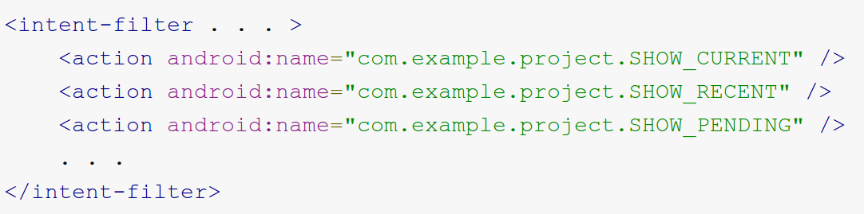
Intent Filters in Action
Filter fields parallel action, data, category fields of Intent
Action test
  Intent action must match one of the filter actions

Slide 14
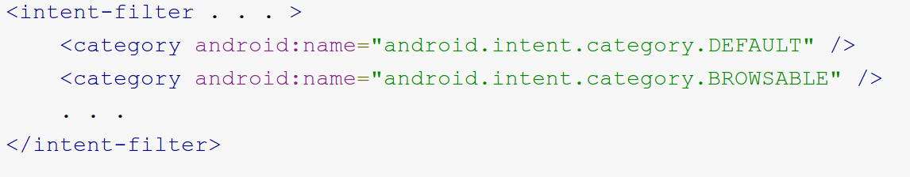
Intent Filters in Action
Category Test
  Every Intent category must match a category in the filter
    NB! intents passed to startActivity() are assigned "android.intent.category.DEFAULT"

Slide 15
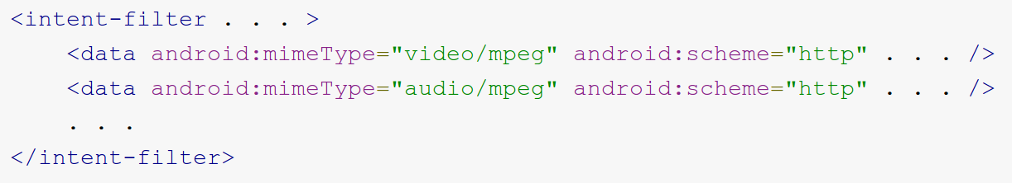
Intent Filters in Action
Data Test
  specify URI and data type
  separate attributes for URI parts (scheme, host, port, and path)
  Intent URI is compared to the parts of the URI in filter
  ex. <data android:mimeType="image/*" />
    <data android:scheme="http" android:type="video/*" />

Slide 16
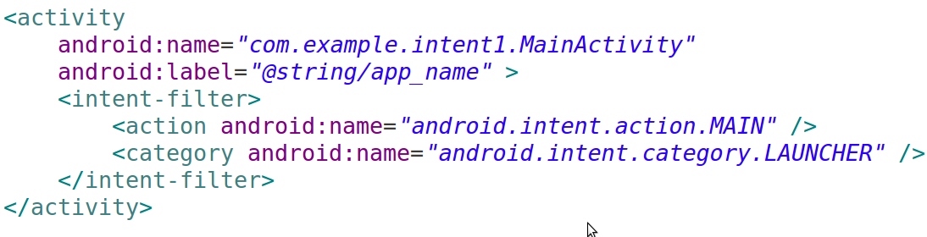
Intent Filters in Action
Activities that can initiate applications have filters with "android.intent.action.MAIN" action
Activities to be represented in the application launcher specify "android.intent.category.LAUNCHER" category

Slide 17
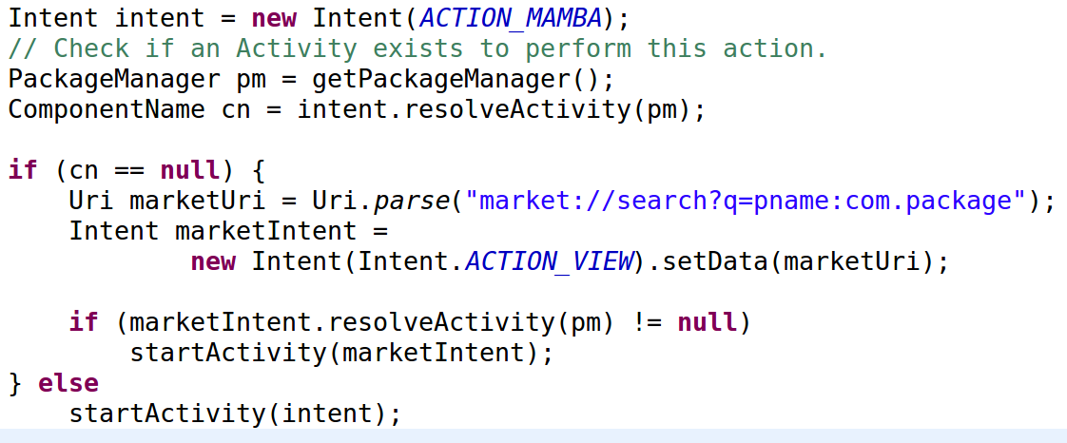
Intent Kung Fu
Determining if an Intent will resolve before calling startActivity

Slide 18
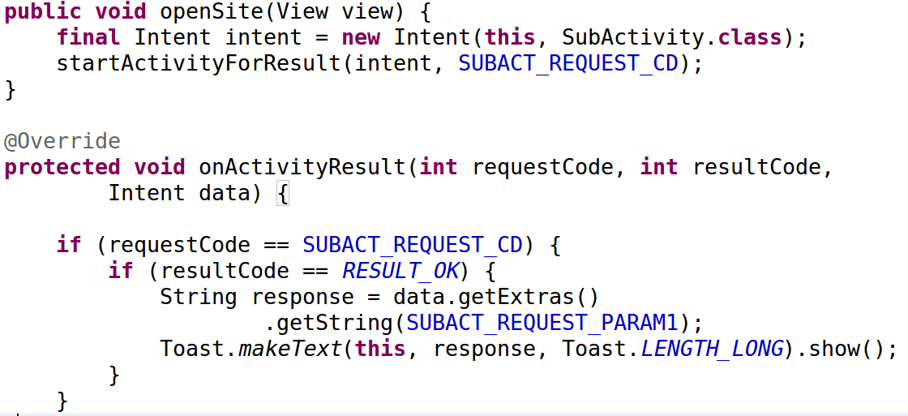
Intent Kung Fu
Returning result from Activities
  Start Activity as a sub-Activity that can pass results back to its parent

Slide 19
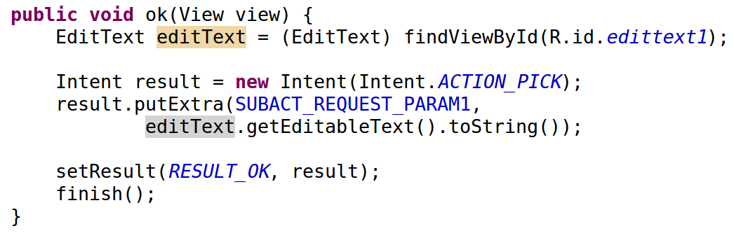
Intent Kung Fu
Returning result from Activities

Slide 20
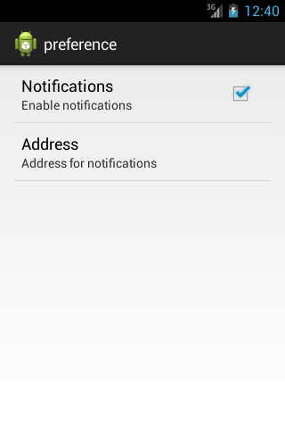
Intent Practical
A) Application Preferences
  Continue working on Purchase list application
  Add new activity that extends PreferenceActivity
    base class for an activity to show a hierarchy of preferences
  Use xml configuration (res/xml/pref.xml)
  Call preferences screen with explicit Intent

Slide 21
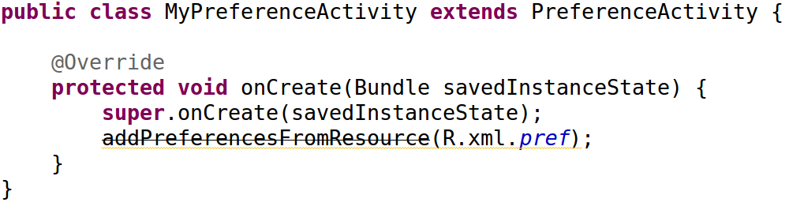
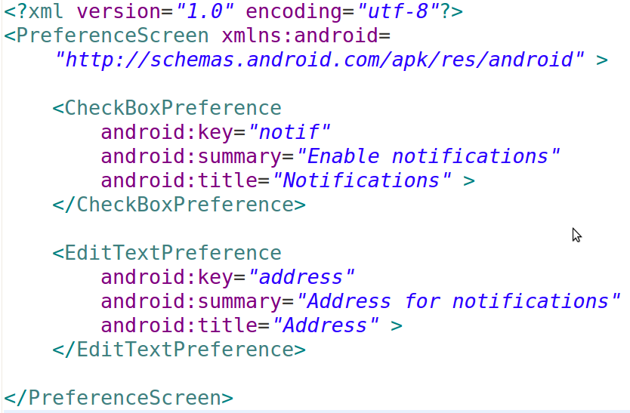
Intent Practical

Slide 22
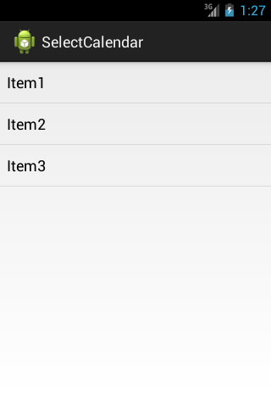
Intent Practical
B) Purchase list select activity
  Continue working on Purchase list application
  Add new activity SelectPurchaseBasket to choose one of possible baskets for goods
    Use ListView with items populated from resource
  Use implicit Intent to start SelectPurchaseBasket via startActivityForResult()
  Return selected basket item from SelectPurchaseBasket via setResult()
  Show selected list item text in MainActivity

Slide 23
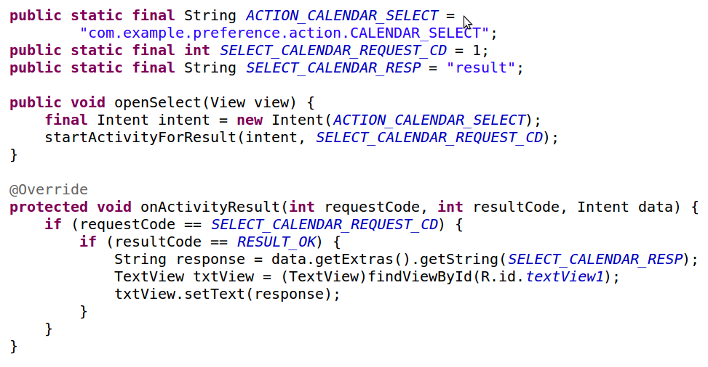
Intent Practical
Main Activity

Slide 24
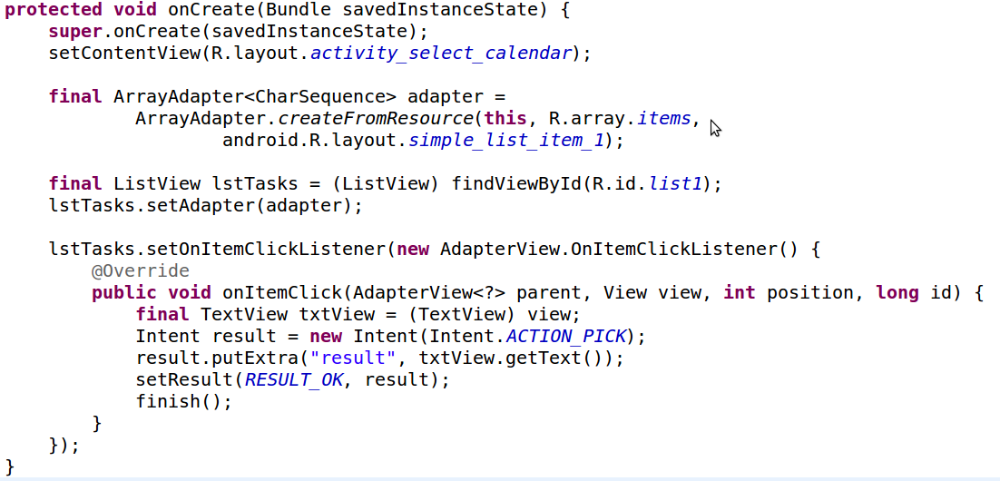
Intent Practical
List item select Activity

Slide 25
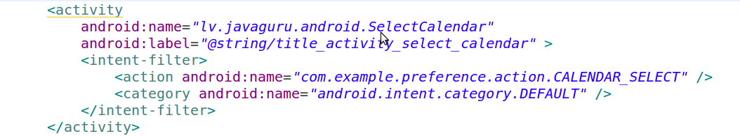
Intent Practical
Intent Filter in AndroidManifest.xml

Slide 26
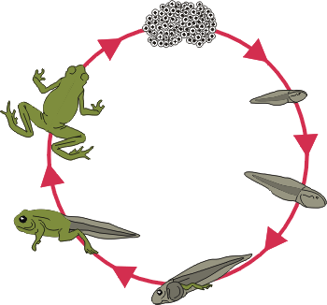
Activity Life Cycle

Slide 27

Android Application
One or more loosely bound Activities
  Typically, one is marked “main”
  Each activity can start another via Intents
Has its own process with separate instance of Dalvik by default
Limited control over own lifecycle. Instead, application components must listen for changes in the application state and react accordingly

Slide 28
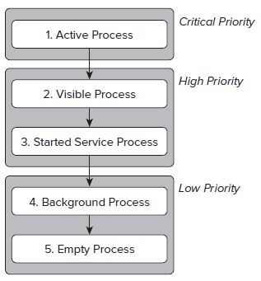
Android Application
Android aggressively manages its resources to ensure smooth UX
Processes (and their hosted applications) might be killed to free resources for higher-priority applications
Application’s priority is influenced by its highest-priority Activity

Slide 29

Activity Stacks
Activities are managed as activity stack ("back stack").
  user is switching activities
  new activity is placed on the top and becomes the running one
  previous activity remains below it in the stack, and will not come to the foreground again until the new activity exits

Slide 30
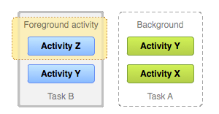
Multitasking
Task - collection of activities user interacts with performing a certain job
Home screen – task starting place
  Application's task comes to the foreground when user touches an icon in the application launcher
  New task is created and "main" application activity opens as the root activity if no task exists

Slide 31
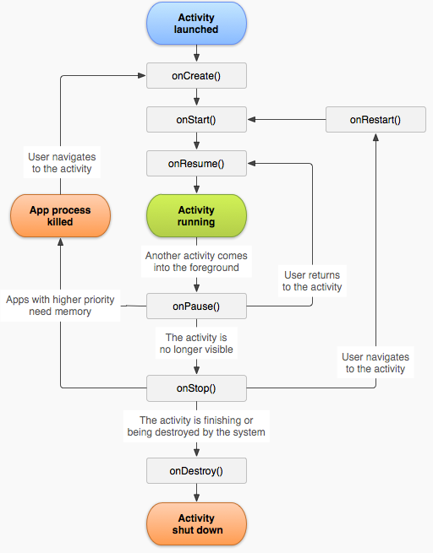
Activity States
Activities transition four possible states
  Active — activity is at the top of the stack, visible, focused
  Paused — visible Activity without focus
  Stopped — when Activity isn’t visible, it “stops.”
  Inactive — after Activity is killed, and before it’s been launched

Slide 32
Activity States
Activity has callback methods to perform operations when the Activity moves between states
  onCreate() - initialize the essential components. Define the layout for the activity's user interface via setContentView()
  OnPause() - commit any changes that should be persisted beyond the current user session

Slide 33
Activity Lifetimes
Full Lifetime
  between the first call to onCreate and the final call to onDestroy
Visible Lifetime
  bound between calls to onStart and onStop
Active Lifetime
  starts with onResume and ends with onPause

Slide 34

Saving Activity State
Problem
  When an activity is paused or stopped, its state is retained while Activity object is held in memory
  After an activity is destroyed the system cannot simply resume activity with its state intact
Solution
  The system recreates destroyed Activity object if the user navigates back to it

Slide 35
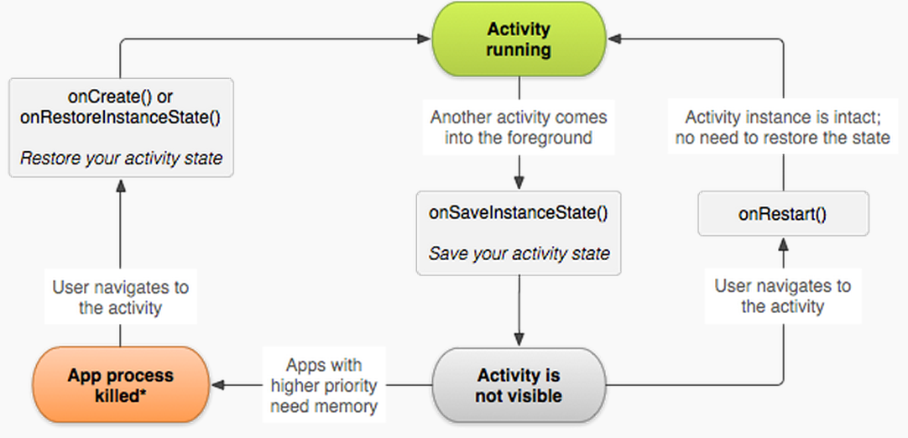
Saving Activity State
Activity state can be preserved with onSaveInstanceState() callback
To restore use onCreate() and onRestoreInstanceState()

Slide 36

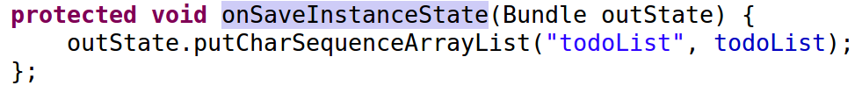
Saving activity state
Save state information about the activity as name-value pairs in a Bundle
onSaveInstanceState() is not guaranteed to be called, never use it to store persistent data (use onPause())
onSaveInstanceState() method is called for every View in the layout by default

Slide 37
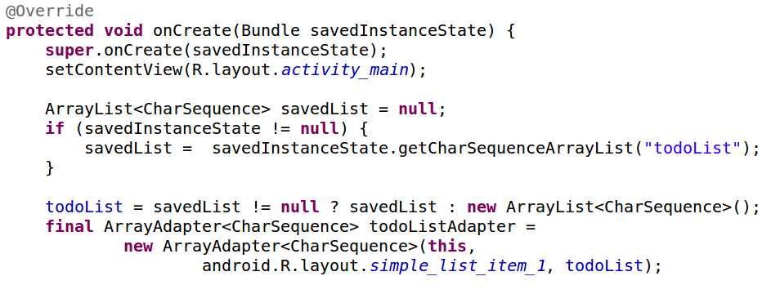
Activity Practical
Improve purchase list application UX
  Continue working on Purchase list application
  Save and restore state information about purchase list entries

Slide 38
Application Manifest

Slide 39
Application Manifest
Essential information about the application
Names Java package for the application
Specifies application metadata (icon, version number, theme)
Describes components of the application
Declares application permissions
Declares Android API versions
Lists the libraries that the application must be linked against
<action>
<activity>
<activity-alias>
<application>
<category>
<data>
...
<intent-filter>
<uses-feature>
<uses-library>
<uses-permission>
<uses-sdk>

Slide 40
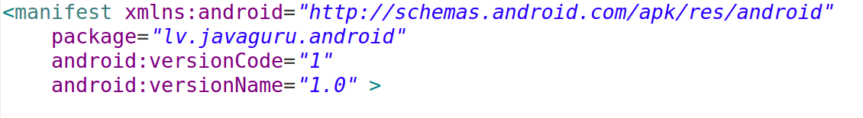
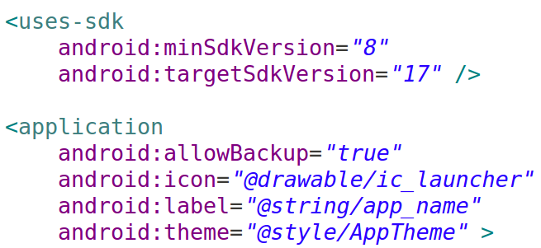
Application Manifest
The minimum SDK version specifies the lowest version supported
The target SDK version specifies the platform used for development and testing.

Slide 41
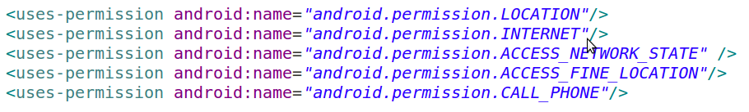
Permissions
A permission limits access to a part of the code or to data on the device
Application must declare that it requires that permission with a <uses-permission>
An application can also protect its own components (activities, services, broadcast receivers, and content providers)

Slide 42
Features
Use uses-feature nodes to specify which features your application requires
Prevents your application from being installed on a device w/o required piece of hardware
<uses-feature android:name=”android.hardware.nfc” />

Slide 43

Workshop

